Slide 1
CS 608 Algorithms
Week 6 Dr. Tom Schmidt

Slide 2
Week 6 Agenda
Jaribio
Visualizing Algorithms
Hashing About
Google Interview
Homework
Wrap-up and review

Slide 3
Quote of the day
"Always code as if the guy who ends up maintaining your code will be a violent psychopath who knows where you live." (John Wood)

Slide 4
Jaribio
1) Suppose you could eliminate 2^n * 2^n permutations from consideration in sorting. Would this affect your running time or number of comparisons you’d have to make in sorting?
2) Answer two of these three
What is the Big O and Big Omega of searching for an item in a hashtable? How does each come about?
B) Suppose you hashed 1000 items into a table of 100000 locations. How many collisions would you expect?
C) What would be a better modulus for a hash function, 59 or 97? Justify your answer.

Slide 5
Visualizing Algorithms
From here

Slide 6
Hashing About
From here

Slide 7
Google Interview
A member of Teams Neuschwanstein and Hamburg

Slide 8
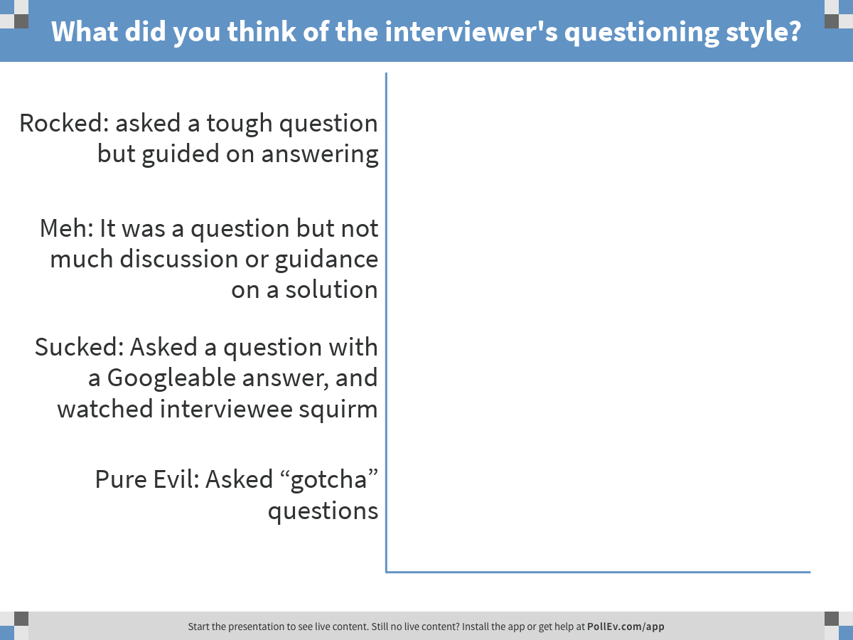
Notes:
What did you think of the interviewer's questioning style?
https://www.polleverywhere.com/multiple_choice_polls/gXPkEw1cpnly2ho

Slide 9
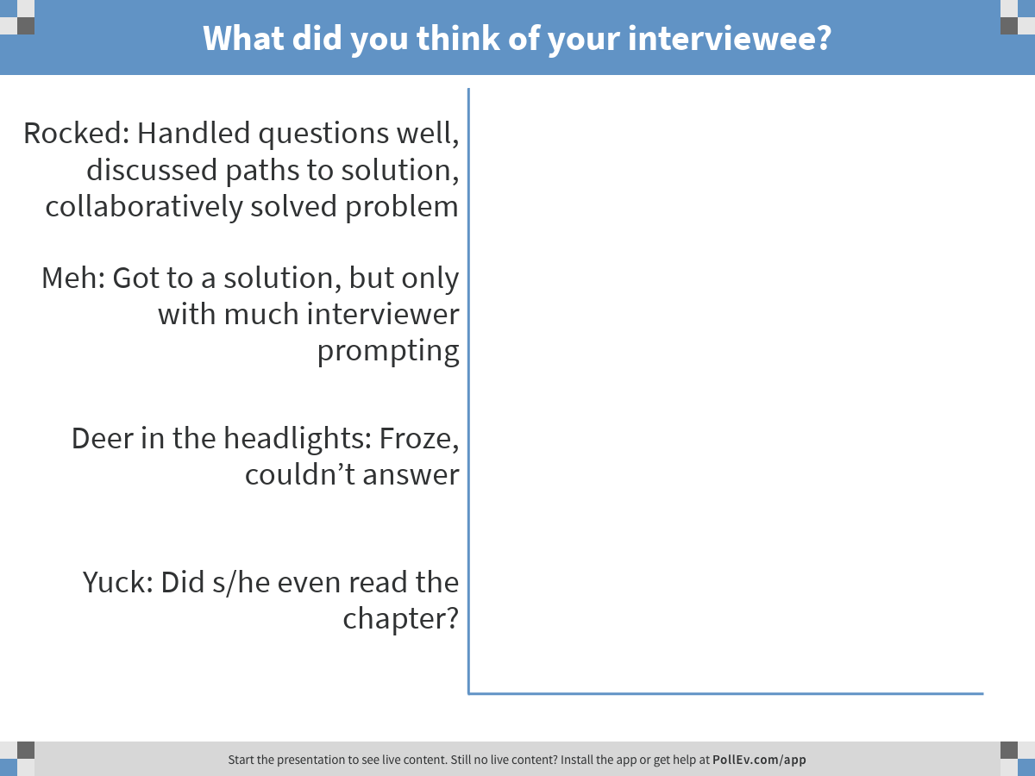
Notes:
What did you think of your interviewee?
https://www.polleverywhere.com/multiple_choice_polls/2Bcwzs8oRbfzQ4C

Slide 10
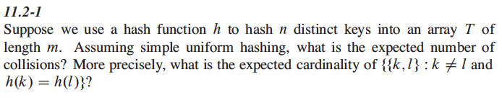
Exercise 11.2-1 Team Goethe

Slide 11
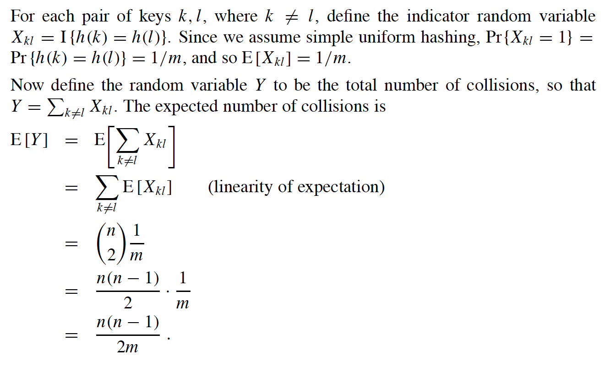
Exercise 11.2-1 Team Goethe

Slide 12
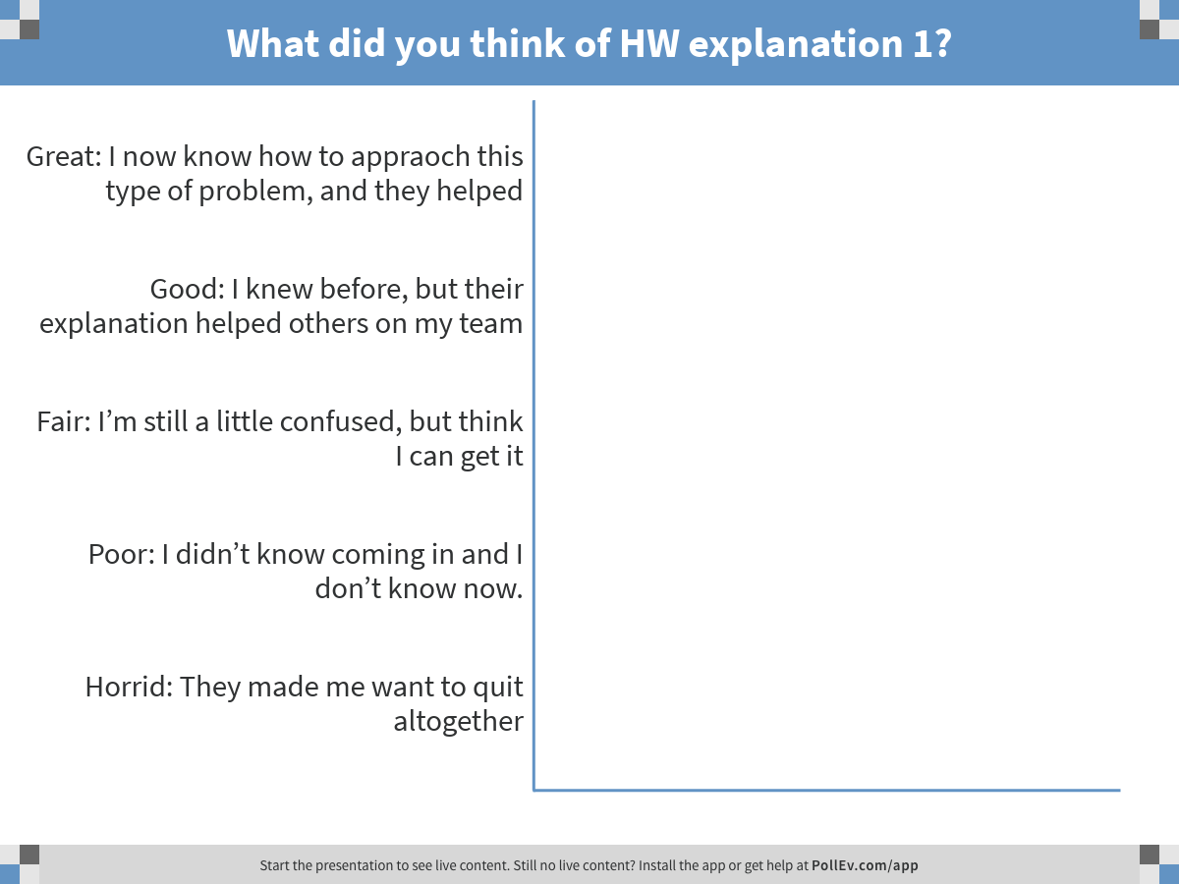
Notes:
What did you think of HW explanation 1?
https://www.polleverywhere.com/multiple_choice_polls/8vmrgZ3VhcBHQvH

Slide 13
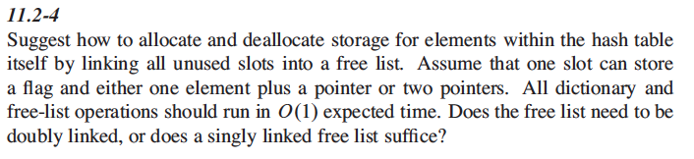
Exercise 11.2-4: Team BMW

Slide 14
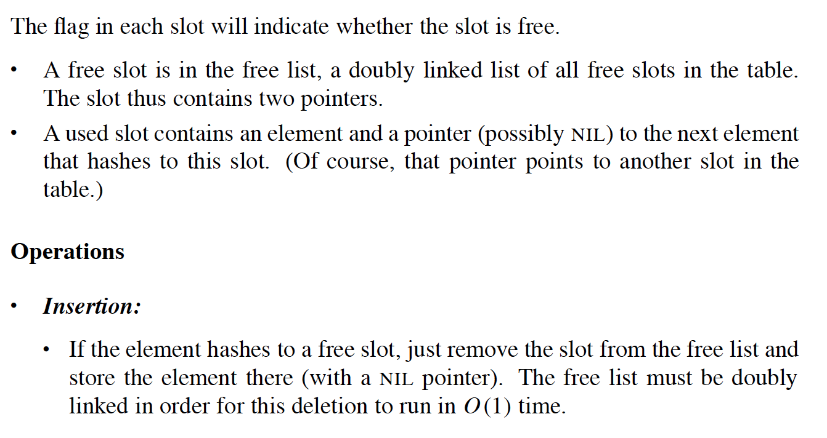
Exercise 11.2-4: Team BMW

Slide 15
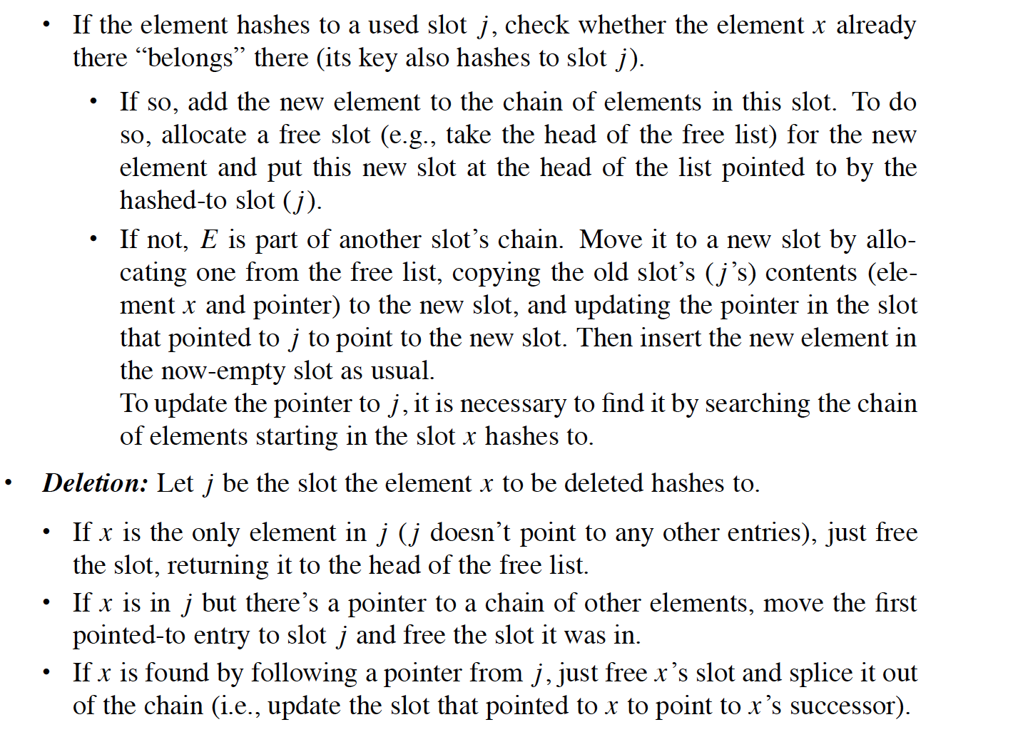
Exercise 11.2-4: Team BMW

Slide 16
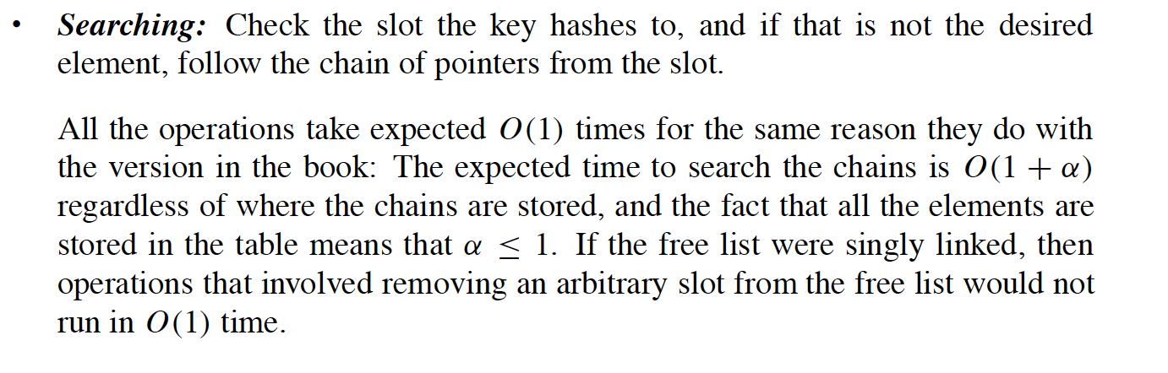
Exercise 11.2-4: Team BMW

Slide 17
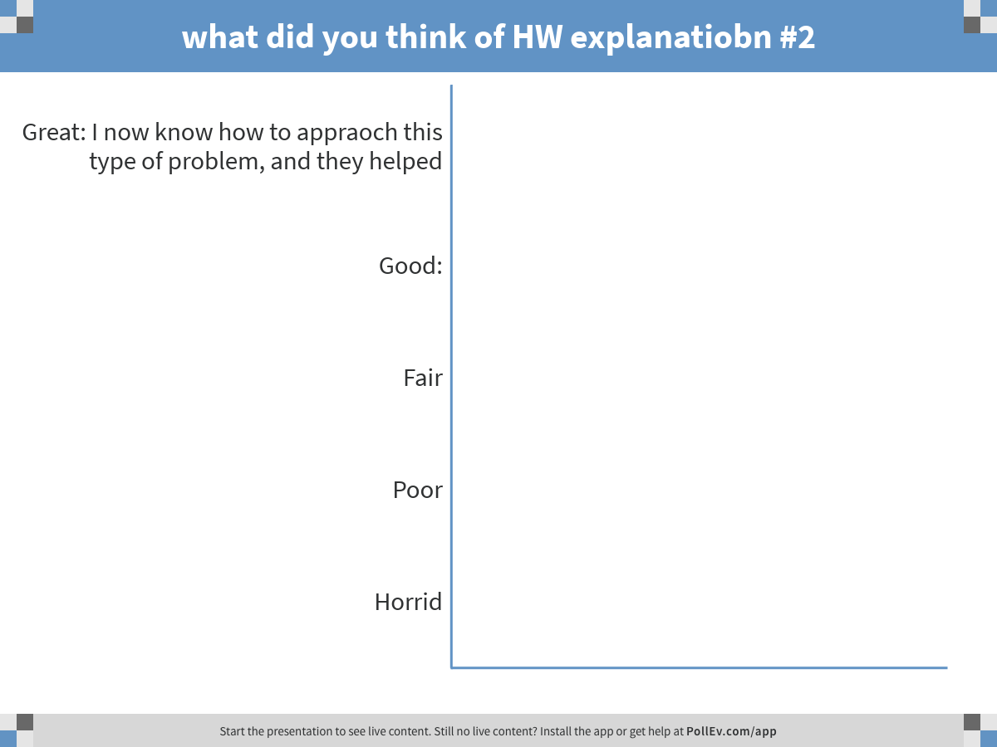
Notes:
what did you think of HW explanatiobn #2
https://www.polleverywhere.com/multiple_choice_polls/BL1zpHfb2mm0Ruz

Slide 18
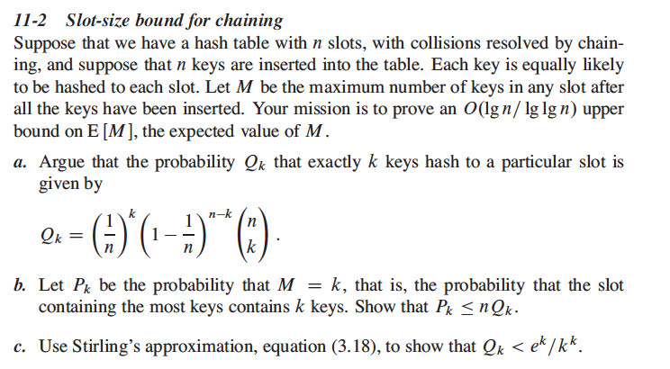
Problem 11.2: Team Brandenburg

Slide 19
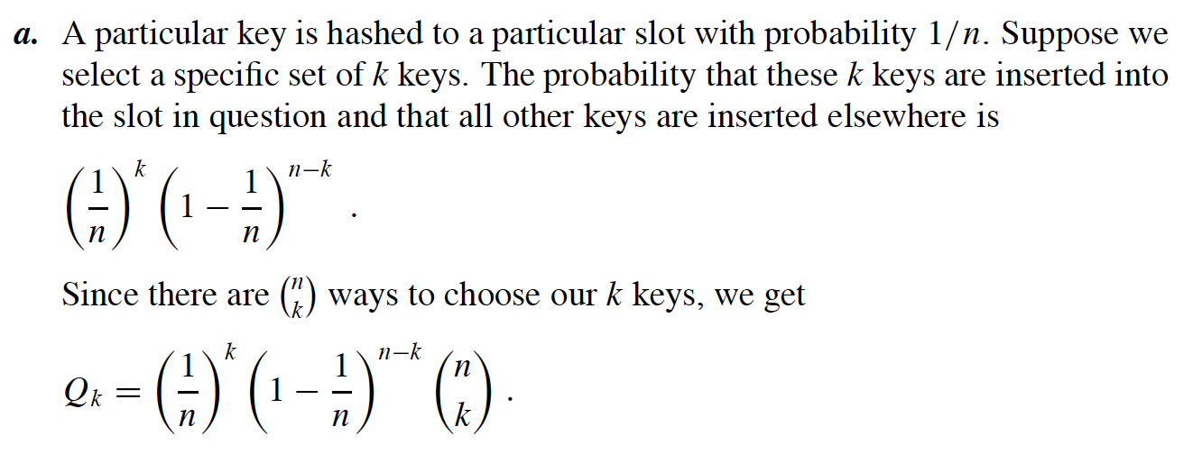
Problem 11.2: Team Brandenburg

Slide 20
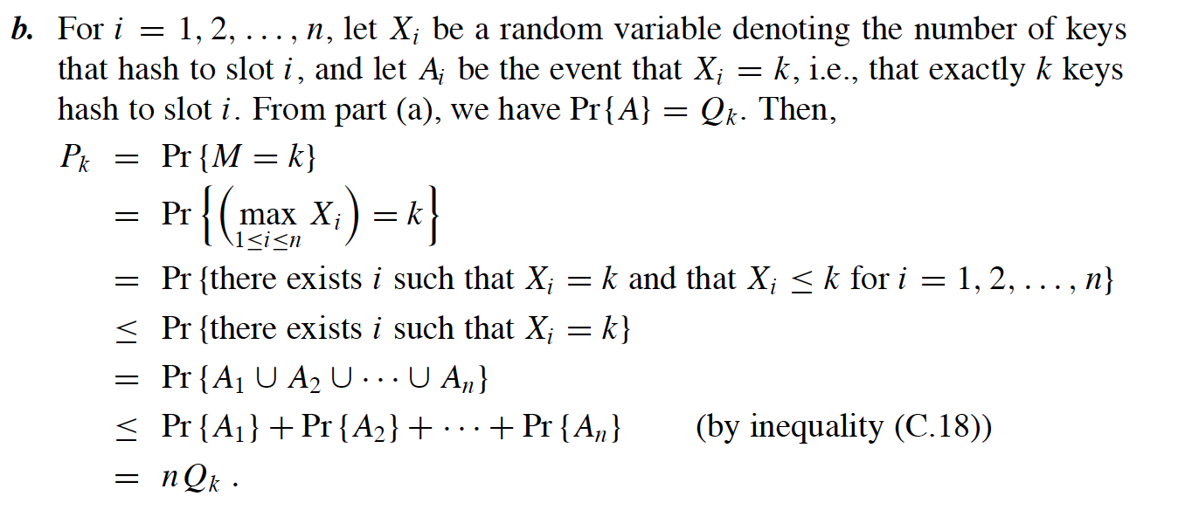
Problem 11.2: Team Brandenburg

Slide 21
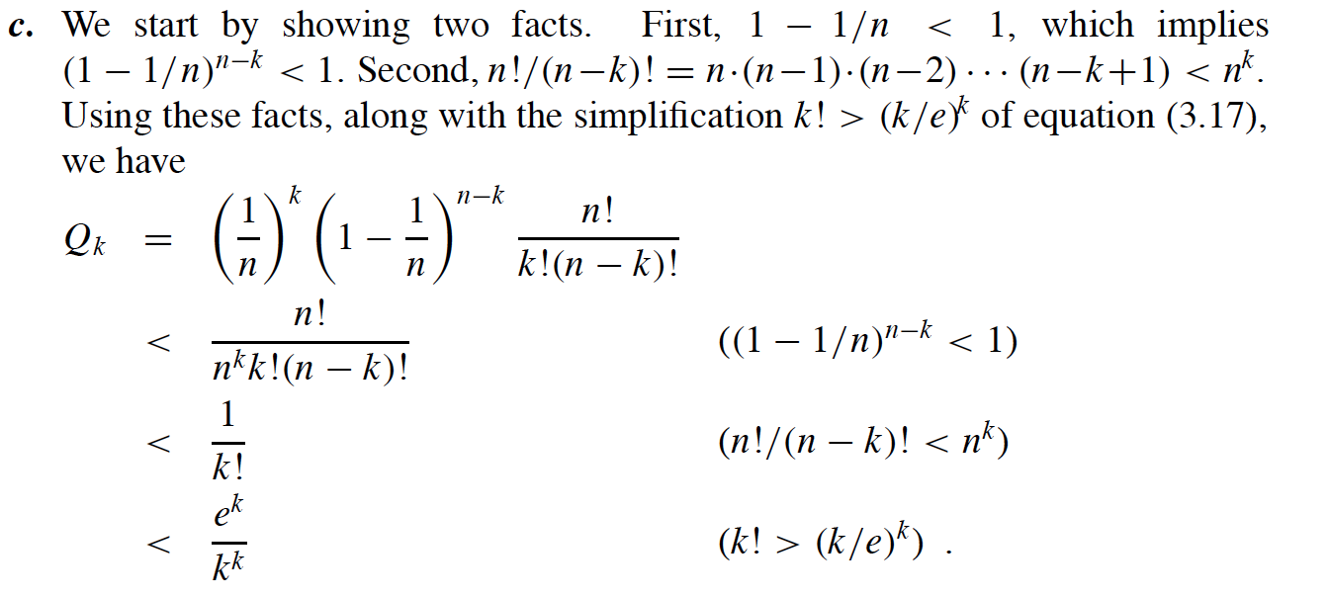
Problem 11.2: Team Brandenburg

Slide 22
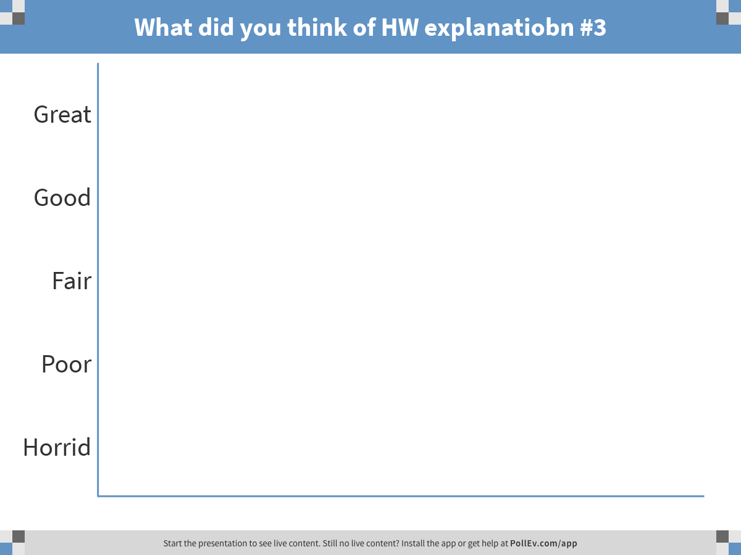
Notes:
What did you think of HW explanatiobn #3
https://www.polleverywhere.com/multiple_choice_polls/Yafw9lfl8l8gPr8

Slide 23
Wrap-up and review
How are your other courses this semester going?
How does this course compare to your other courses: harder/easier, better/worse, funnier/sadder, etc?
Thank you and Allin tuta (Quechua?)

